Slide 1




Parcel

Slide 2

What is parcel?
A build tool for the rest of us.
Parcel starts with a great development experience, from starting a new project, to iterating and debugging, and shipping to production. No more fiddling with configuration, or spending hours to keep up with best practices – it just works!

Slide 3
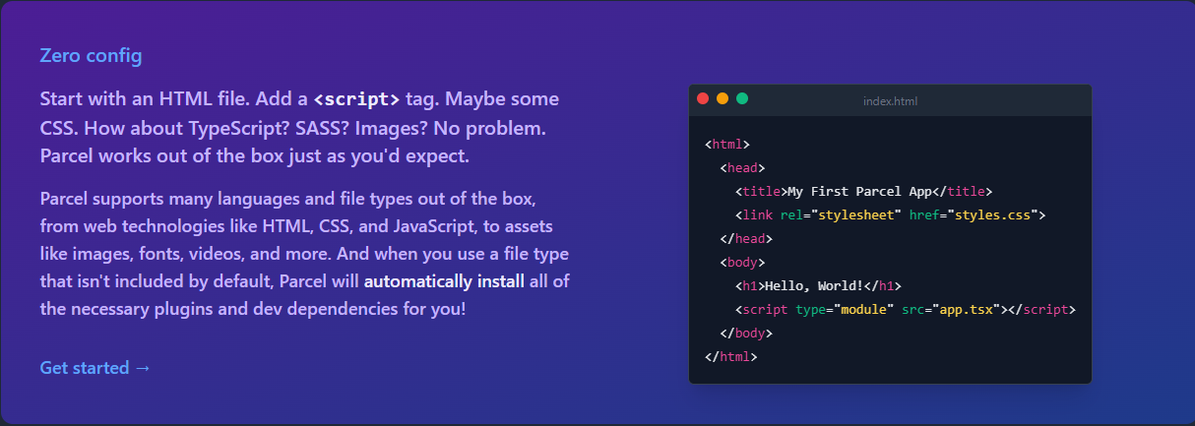
Parcel has:

Slide 4
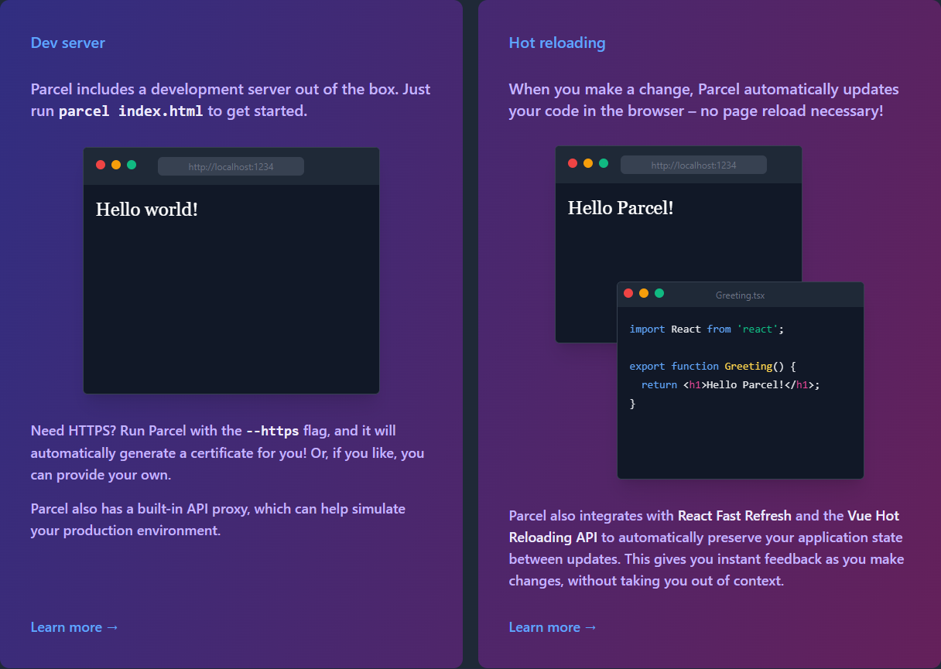

Slide 5
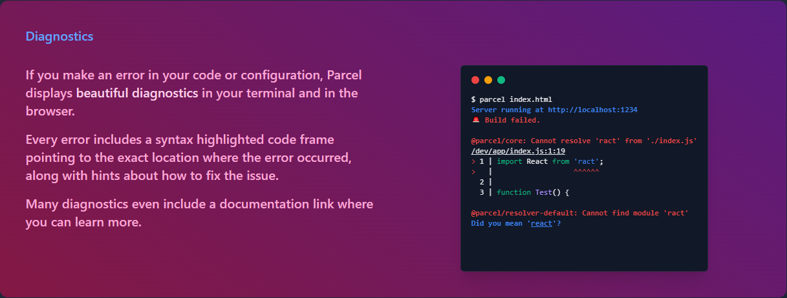

Slide 6
It's lightning fast.
Parcel builds your code in parallel using worker threads, utilizing all of the cores on your machine. Everything is cached, so you never build the same code twice. It's like using watch mode, but even when you restart Parcel!
Parcel's JavaScript compiler, CSS transformer, and source maps implementation are written in Rust for maximum performance. It's 10-20x faster than other JavaScript-based tools!
Parcel's CSS transformer and minifier is built in Rust on top of the browser-grade CSS parser used in Firefox. It's over 100x faster than other JavaScript-based transformers and minifiers.

Slide 7
